Slide 1

In Search of efficiency
Predicting Garment Employee productivity
By: Tamjid Ahsan
Date: May 27, 2021, 05:00 PM [DST]

Slide 2
Overview
The garment industry one of the highly labor-intensive industries.
Often production goals are not met.
This is a high priority for an organization to achieve deadline and maximize profit by ensuring proper utilization of resources.
Critical component of Lean manufacturing

Slide 3
Business Problem
A garment production pipeline consists of a handful of sequential processes, e.g., designing, sample confirmation, sourcing and merchandising, lay planning, spreading and cutting, sewing, finishing and so on.
To complete a whole production within a target time, these sequential processes need to be to performed efficiently. Industrial engineers strategically set a targeted productivity value against each working team in the manufacturing process.
However, it is a common scenario that the actual productivity does not align with the target for several factors, both internal and external.
The goal is to predict whether employee met productivity, with high precision.

Slide 4
Methodology
The collected dataset contains the production data of the sewing and finishing department for three months from January 2015 to March 2015 of the renowned garment manufacturing company in Bangladesh.
Cleaned dataset consists of 1197 instances and includes 13 attributes.
Machine Learning models were used for predicting binary classification.
Target met OR not met.
Focus was on maximizing prediction the instances where production target were
not met with high confidence.
Using “random subsampled decision trees” modeling technique yielded
best performance.
Accuracy of 100%. (Quite uncommon outcome)

Slide 5

Let's start with some exploration
Only the Prominent Ones

Slide 6
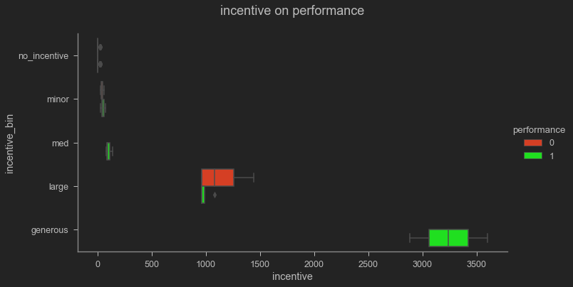
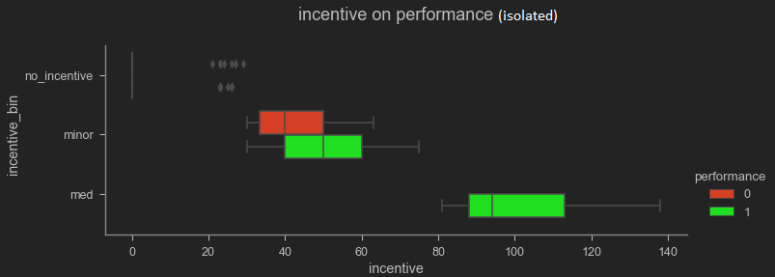
Incentive
Even a minor incentive have positive impact on performance.

Slide 7
Incentive
Even a minor incentive have positive impact on performance.

Slide 8
Incentive
Even a minor incentive have positive impact on performance.

Slide 9
Incentive
Even a minor incentive have positive impact on performance.
Try to give incentive if possible

Slide 10
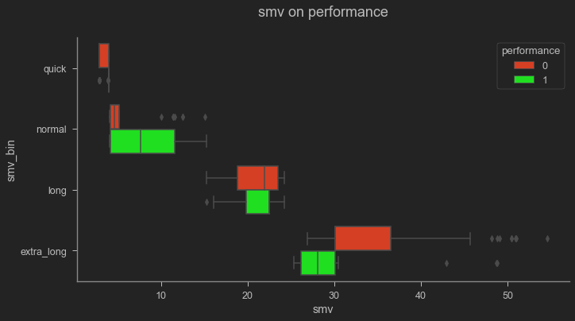
SMV standard Minute value
Higher or lower value tends to lead towards goal not met.
Re-evaluate assigned minute values, or train workers to be more efficient

Slide 11
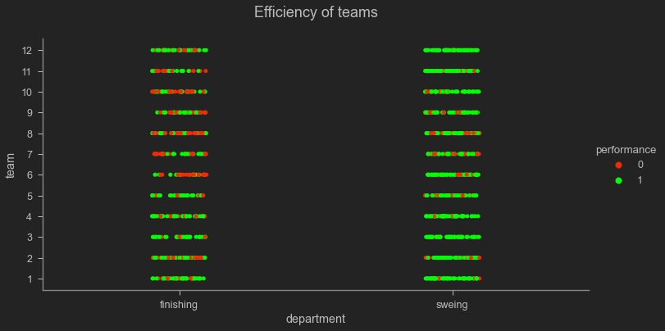
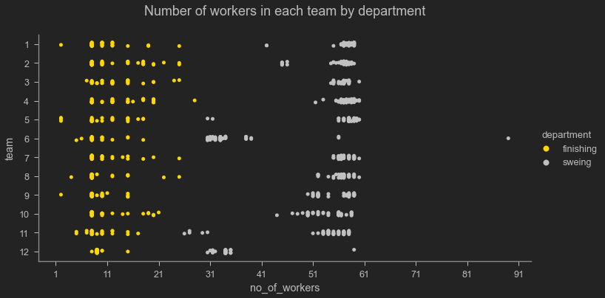
Team
Generally finishing department worker size is low.
Finishing department fails to achieve goal more often.
Do they have enough manpower?

Slide 12
Peeking into a black box
Random Subsampled Decision Trees

Slide 13
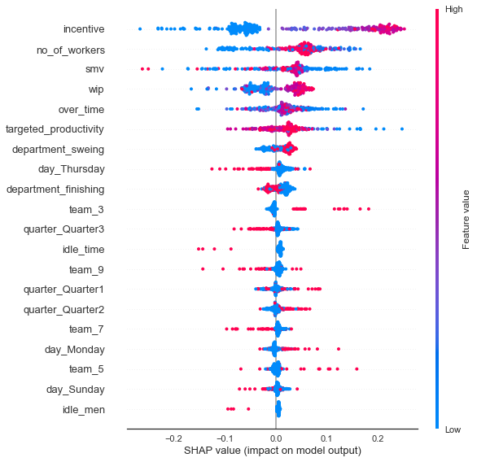
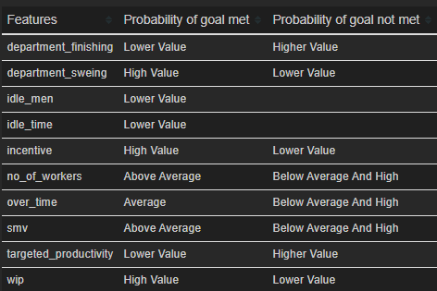
Feature Importance

Slide 14
Recommendations
Use insights to tune manufacturing process as is.
Use this model for predicting performance and tune production process accordingly.

Slide 15
Next steps
do a multi-class prediction by further binning of target.
fit a model with entire data and prepare for production use.

Slide 16
THANK YOU
GitHub: @tamjid-ahsan
LinkedIn: linkedin.com/in/tamjidahsan/
Project repo: https://github.com/tamjid-ahsan/dsc-phase-3-project

Slide 17

Appendix

Slide 18
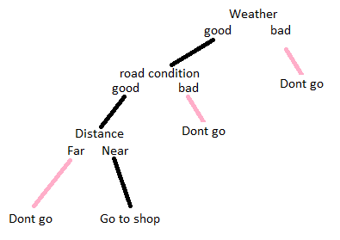
Random Forest™ A.K.A. Random Subsampled Decision Trees
Let's start with a decision tree
A hypothetical scenario
You want to go to grocery to by potato.
You either go or don’t.
Factors influence
Weather
Distance
Road condition
* The actual process is much more complex than that. This example is more of a flow chart.

Slide 19
Random Forest™ A.K.A. Random Subsampled Decision Trees
Random Subsampling
Best performing trees?
Different combination of:
Weather
Distance
Road condition
You want to buy either an iPhone or android. Then ask three of your friends about suggestion.
Friend 1 says to buy an iPhone because of the brand value.
Friend 2 says to buy an Android phone because it is affordable.
Friend 3 says to buy an iPhone because of the cameras.
Now you found out that the majority of your friends suggested an iPhone. You decided to buy an iPhone after finding out which decision gets the majority votes. This is the basic idea behind the Random forest classifier.
Trees, with an emphasis on the “s”
Creates a hoard of those trees and measures performance.
Then selects the best performing trees.

Slide 20
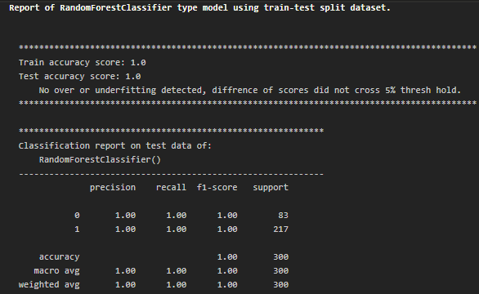
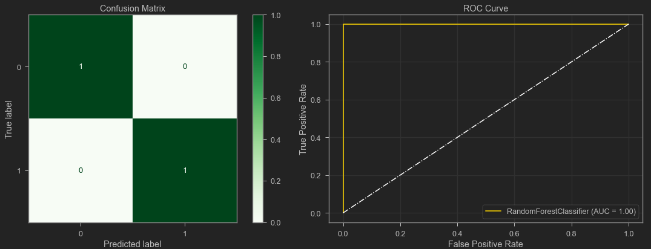
Performance Metrics of the RF model

Slide 21
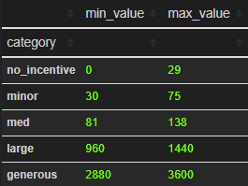
Incentive Binning

Slide 22
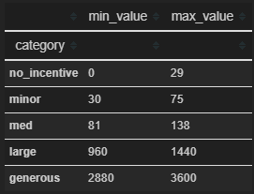
SMV Binning

